Slide 1
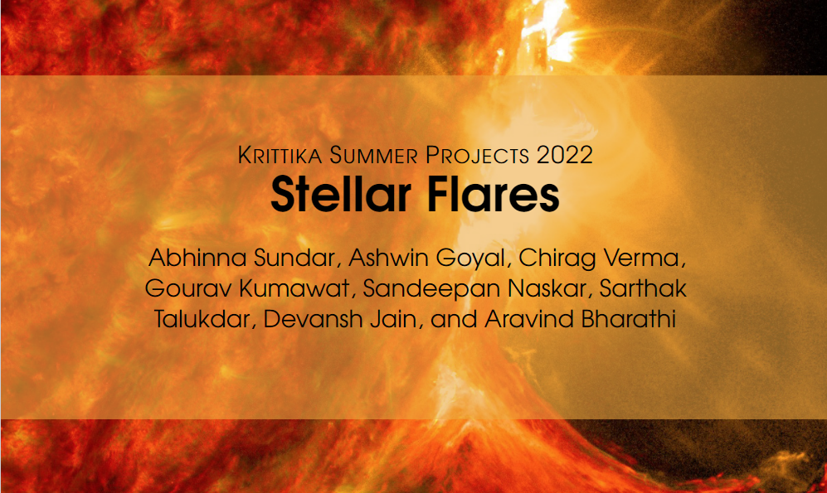

Slide 2
Abstract
We replicated the earlier models for the purpose of explaining a variety of stellar flares. We also provided our own amendments and potential issues with the existing models.
We assumed that a flare consists of two components, the first of which rises in brightness quickly and relatively strongly, the second of which is slower and fainter. The latter is the consequence of the star’s photosphere reflecting some of the energy from the first rise.
The model is primarily based on just geometric considerations on the light curve.

Slide 3
Background
Flare activity often occurs or is constantly present in the early stages of stellar evolution. However, star formation theories essentially ignore this fact. The flare event could be crucial for comprehending star creation and early development.
Understanding the mechanism(s) of flare is complicated by the broad range of light curve morphologies.

Slide 4

Background
Flare activity often occurs or is constantly present in the early stages of stellar evolution. However, star formation theories essentially ignore this fact. The flare event could be crucial for comprehending star creation and early development.
Understanding the mechanism(s) of flare is complicated by the broad range of light curve morphologies.
Elementary Flare Profile
We employed a straightforward mathematical formula (Equation eq1) that describes a so-called elementary soft X-ray flare time profile in order to understand specific flare brightenings seen on the light curve.

Slide 5
Observation and Datasets
The Solar X-ray Monitor (XSM), onboard Chandrayaan-2, is an instrument of the India’s lunar mission launched on July 22, 2019. XSM continuously monitors the Sun and measures the Solar spectrum in the energy ranges of 1 − 15 keV with an energy resolution of ∼ 175 eV at 5.9 keV.

Slide 6
Observation and Datasets
The Solar X-ray Monitor (XSM), onboard Chandrayaan-2, is an instrument of the India’s lunar mission launched on July 22, 2019. XSM continuously monitors the Sun and measures the Solar spectrum in the energy ranges of 1 − 15 keV with an energy resolution of ∼ 175 eV at 5.9 keV.
Aim and Objectives
The goal primarily comprises of detection, identification, and analysis of Solar Flares in X-Ray Light curves observed by XSM. This will help us in developing a robust and reliable pipeline for XSM temporal data. The XSM has more sensitivity than the GOES, and its detections are publicly accessible

Slide 7
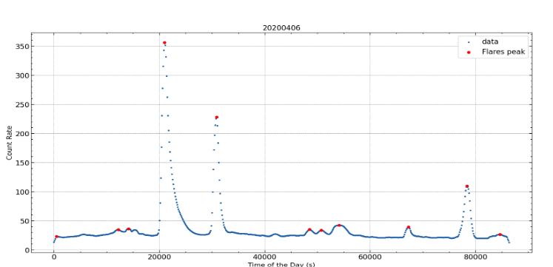
Data pre-processing
Given our data was of one day in length i.e. 86400 s or 24 h. The binning was kept around 50 − 200 s which produced decent results. To clear out the roughness, reduce the noise, and to help us see better trends and patterns in the data, smoothing was done. This also helped in eliminating the outliers in the data.

Slide 8
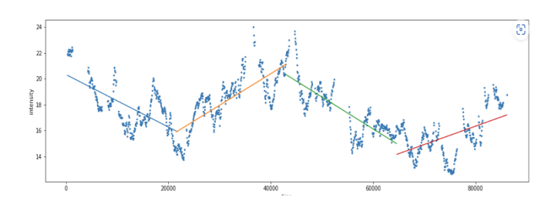
Constant Background Fits
We fitted a constant line to the full day data after removal of the initial detected flares. Those flare peaks whose count rates were 3σ times higher than the background level were eliminated. We repeated this process till the background level i.e. const + 3σ level converges.
Linear and Polynomial Background Fits
We fitted a straight line to the noise and remove outliers. This is done, because in the case of multiple flares, some residual flare data remains from the minima between peaks. For the remaining data, we fitted a polynomial to it, or a set of 3 − 4 straight lines

Slide 9
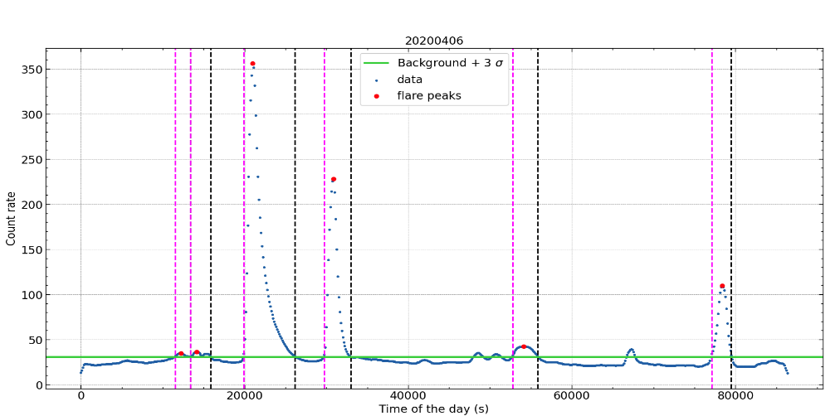
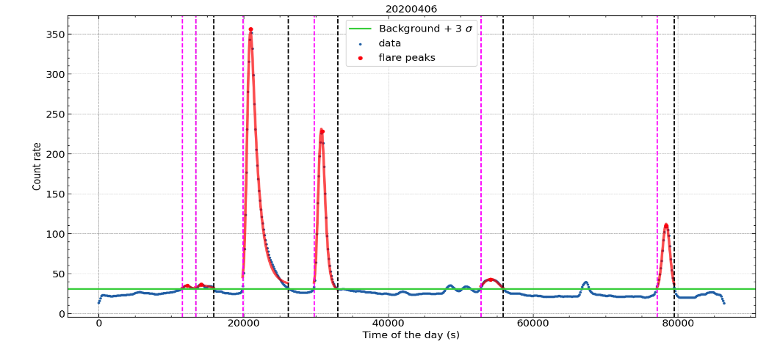

Slide 10
Results, Discussions and Conclusions
1. The increment in the threshold value for the slope in the trigger algorithm caused various peaks to be non-detectable. We have to find a better way to resolve and fix a particular threshold.
2. Inaccuracies in the peak detection algorithm cause these flares to not be removed and trickle down into the background. This was the reason we had to include the removal of data beyond 3σ from the background. Moreover, the background at that point had ended up containing many flares.
3. Often, the background data from the algorithm did not span the whole day and this lead to over-fitting. This made it difficult to optimize a single background fitting technique for different days.
4. Apart from this, this algorithm would often capture multiple flares and call them a single flare. This led to bad fits that were difficult to resolve.
5. Based on the count rates and the Flares detection algorithms used, we learnt that the solar background fluctuates slowly over time and the solar minima occurred in the year 2020. We found that not all flares have a gaussian rise and an exponential decay.

